Slide 1
Quiz Society
Week 5 – WORLD CUP SPECIAL

Slide 2
Rules
Get into teams of 1-4 people
Have a piece of paper, a writing implement, and a team name prepared
There will be 5 rounds, with 6 questions per round
2.5 minutes per round
The team with the most points at the end wins

Slide 3
ROUND 1
BALLS
OF THE WORLD CUP

Slide 4
MATCH
MAKER

Slide 5
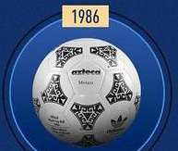
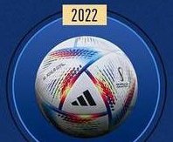
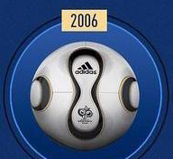
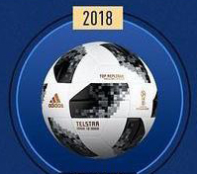
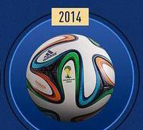
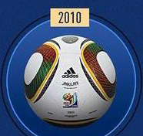




MATCH THE BALL TO ITS NAME
BRAZUCA
TELSTAR
AL RIHLA
JABULANI
TEAMGEIST
AZTECA

Slide 6
ROUND 2
TOP
SCORERS

Slide 7
WHO IS THE TOP GOALSCORER IN WORLD CUP HISTORY?
HOW MANY GOALS HAS THE TOP GOALSCORER IN WORLD CUP HISTORY SCORED?
HOW MANY GOALS IN OPEN PLAY DID HARRY KANE SCORE IN 2018?
WHAT CLUB SIDE DID JAMES RODRIGUEZ PLAY FOR IN THE SEASON WHEN HE WAS THE TOP GOALSCORER IN 2014?
WHAT AWARD IS GIVEN TO THE TOP GOALSCORER AT EACH WORLD CUP?
WHO WAS THE TOP GOALSCORER IN THE 2002 WORLD CUP ?

Slide 8
ROUND 3
THE FIRST SECTION OF
RONALDO
‘S WIKIPEDIA PAGE

Slide 9
IN WHICH YEAR WAS HE BORN?
HOW MANY BALLON D’OR AWARDS HAS HE WON?
WHEN DID HE JOIN MANCHESTER UNITED FOR THE FIRST TIME?
WHEN DID HE JOIN MANCHESTER UNITED FOR THE SECOND TIME?
IN WHICH EUROS DID HE WIN THE GOLDEN BOOT?
TO WITHIN 10, HOW MANY GOALS HAS HE SCORED IN THE CHAMPIONS LEAGUE?

Slide 10
ROUND 4
FLAGS
OF COUNTRIES IN THE WORLD CUP
BUT RAINBOWS ARE ILLEGAL IN QATAR

Slide 11
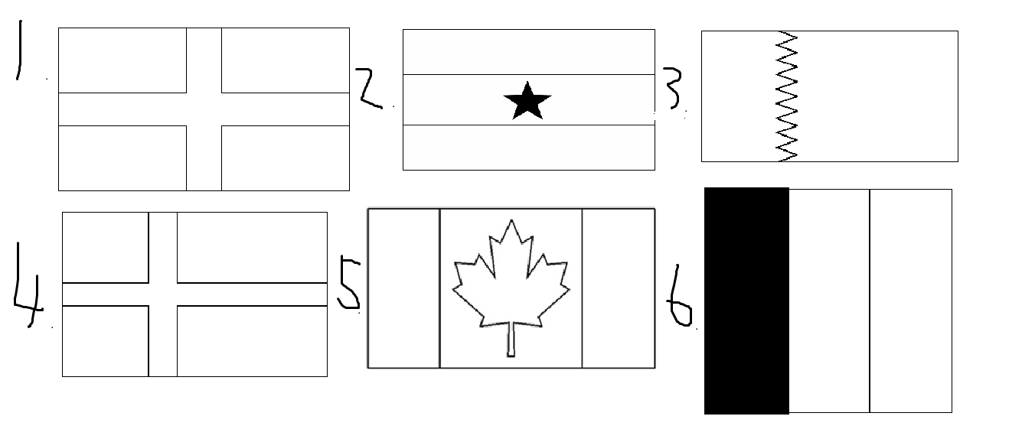
NAME THE COUNTRY

Slide 12
ROUND 5
GUESS THE PLAYER AT THE WORLD CUP
BY
THEIR TRANSFER

Slide 13
RISK IT
FOR
THE BISCUITS

Slide 14
RULES
Earn bonus points by getting multiple answers correct
2 correct answers – 1 Bonus Point
4 correct answers – 2 Bonus Points
6 correct answers – 3 Bonus Points
HOWEVER
Get 1 question wrong, and score 0 points for the entire round
Leave an answer blank, and it is not counted as wrong

Slide 15

1
2
3
EVERTON
MANCHESTER CITY
4
5
6
REAL MADRID
MANCHESTER UNITED
£50m (2016)
£59.7m (2014)
TOTTENHAM
BAYER LEVERKUSEN
REAL MADRID
CHELSEA
£30m (2012)
£71m (2020)
LAS PALMAS
BARCELONA
LEIPZIG
BAYERN MUNICH
£5m (2019)
£42.5m (2021)

Slide 16
SWAP YOUR PAPERS, IT’S ANSWER TIME
BONUS ROUND

Slide 17
WHAT’S NEXT?

Slide 18
WHAT COMES NEXT?
BUFFON CASILLAS NEUER

Slide 19
SWAP YOUR PAPERS, IT’S ANSWER TIME

Slide 20
ROUND 1
E
D
B
F
C
A

Slide 21
ROUND 2
MIROSLAV KLOSE
16
ONE
MONACO
GOLDEN BOOT
RONALDO (R9)

Slide 22
ROUND 3
1985
5
2003
2021
2020
140

Slide 23
ROUND 4
ENGLAND
GHANA
QATAR
DENMARK
CANADA
BELGIUM

Slide 24
ROUND 5
JOHN STONES
LUKA MODRIC
DAYOT UPAMECANO
ANGEL DI MARIA
KAI HAVERTZ
PEDRI

Slide 25
BONUS ROUND
BUFFON CASILLAS NEUER
COURTOIS
THEY ARE THE GOLDEN GLOVE WINNERS AT THE MOST RECENT WORLD CUPS

Slide 26
COUNT UP THE MARKS
RETURN THE PAPERS TO THEIR ORIGINAL TEAMS
ALL TEAMS REPORT YOUR SCORES
WAIT PATIENTLY WHILE A WINNER IS DECIDED
REVEL IN JOY IF YOU WIN

Slide 27
THE TOP 3 TEAMS MAY EACH SELECT A CATEGORY FOR NEXT WEEK’S QUIZ
A CATEGORY CANNOT BE SELECTED WITHIN TWO WEEKS OF IT BEING USED
AS FOR EVERYBODY ELSE, THANK YOU FOR COMING ALONG

